Slide 1
The Wizards of MMS
Showing You What's Behind the Curtain

Slide 2
Attention
MMS sessions are 60-75 minutes followed by LONG Q&A
Please hold detailed questions until that Q&A starts
Feel free to ask clarification questions
Remind the speakers to use Zoom It when you can’t see

Slide 3

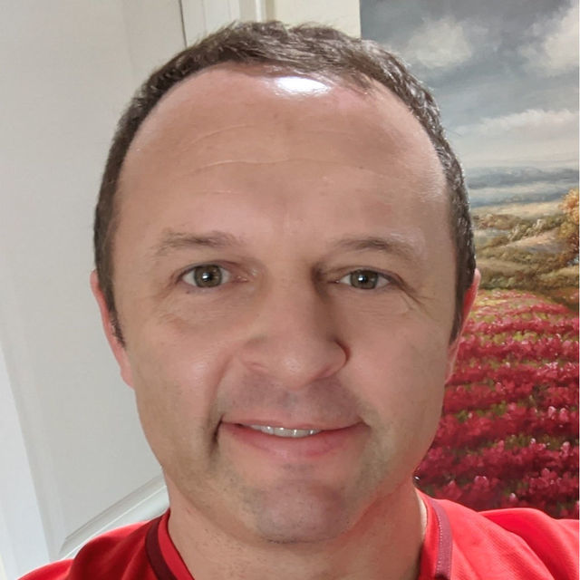

Scott Corio
Greg Ramsey
MMS Staff, Microsoft MVP
MMS Staff, Microsoft MVP
DumpsterDave
in/ScottCorio
gregramsey
in/ramseyg

Slide 4
Our "Architecture"

Slide 5
MMS Architecture
MMS Verify
(hotel, discord)
Azure Services
Logic Apps
Container Apps
Key Vault
Stripe.com
(payment)
Azure Automation
Azure DevOps
Storage
Attendee
Sched.com
(ticketing, scheduling)
SharePoint
(attendee and speaker store)
Speaker
Sessionize.com
(session submission)

Slide 6
Our Toolbox
What we use, and Why we Use it

Slide 7
Our Tools
VSCode
Azure DevOps
Logic Apps
Container Apps (verify.mmsmoa.com)
Key Vault
Storage Accounts
PowerShell

Slide 8
Some of the Automations
verify.mmsmoa.com
Reminder Emails
Speaker Emails
Duplicate Session Signup Detection
Add Attendees to Sched

Slide 9
Verifying People for Discord
According to Brian

